Slide 1
React State Management
Built-In State Management and Libraries
Notes:
What I’ll be presenting on today is React State Management:
We’ll talk about:
What state management is and why its important
What React provides for us out of the box to manage our application’s state
And a couple of popular libraries written to help us manage state
Some of these examples will be straight from the React docs or from the libraries we’ll look at, so I’ll provide links at the end if you’re want to re-review or dig deeper into anything we cover

Slide 2
Why talk about State Management?
UI and State are fundamental elements of any application
Notes:
So, why are we talking about state management?
Well:
UI and state are fundamental elements of any application, let’s think about this quote from ui.dev
“If you were to boil down an app to its two most fundamental components, what you'd get is UI and State.”
So, what that quote is saying is that, two core elements of any app are the UI you interact with, and the state changes that occur when you interact with that UI.
If you think about the business rules in the app, again, it’s our state that changes in coordination with those rules.
So, an app is composed primarily of UI and State.
Now, here’s some more on the quote from above:
“if you were to boil down the root cause for any bug you've ever written, odds are that bug was caused because of state mismanagement. The state the app expected and the state it got were out of sync.
Have you ever thought about why the first rule of tech support is turning it off and back on again? It's because it resets the state and, therefore, fixes the problem.”
So, by increasing the predictability of your state, you can decrease the number of bugs in your application.
And that’s why state management is important.
What is the Store? - ui.dev

Slide 3
Built-In State Management in React
Notes:
Now that we understand why state management is important, let’s talk about the state management tools we’re given out of the box with React.
But before we do that,
it’s important to understand first that React embraces and emphasizes declarative programming, as opposed to imperative programming.

Slide 4
Reacting to Input with State
“React uses a declarative way to manipulate the UI.
Instead of manipulating individual pieces of the UI directly, you describe the different states that your component can be in, and switch between them in response to the user input.
This is similar to how designers think about the UI.”
Notes:
So, the React docs read,
“With React, you won’t modify the UI from code directly. For example, you won’t write commands like “disable the button”, “enable the button”, “show the success message”, etc. Instead, you’ll describe the UI you want to see for the different visual states of your component (“initial state”, “typing state”, “success state”), and then trigger the state changes in response to user input. This is similar to how designers think about UI.”
This is an important concept to understand, and I think an easy one to understand as well with the right mental model.
A metaphor that worked well for me was to make the distinction is that imperative programming would be like if you asked someone for directions to their house,
An imperative response might be:
Managing State – React
Imperative vs Declarative Programming (ui.dev)
Reacting to Input with State – React

Slide 5
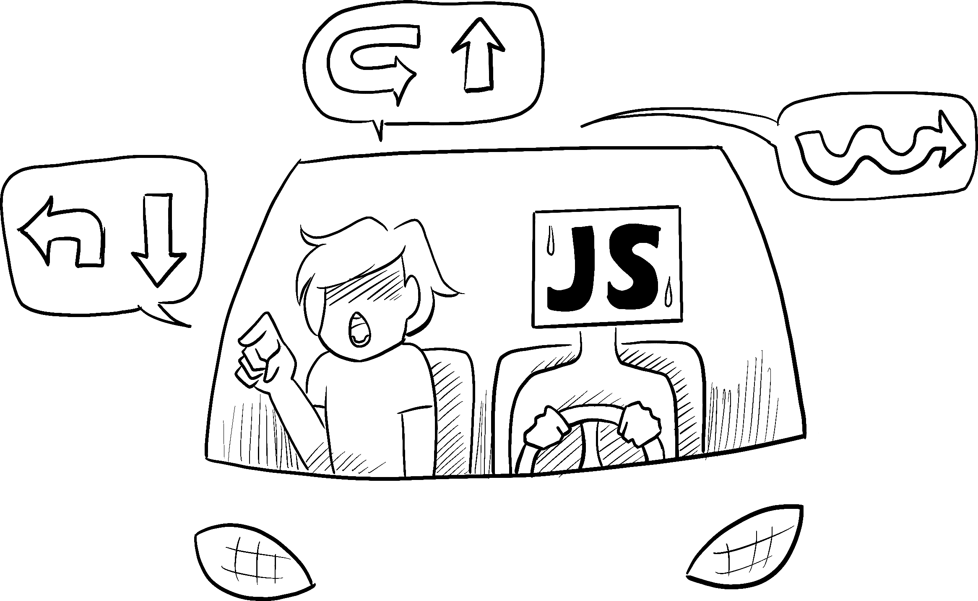
Notes:
IMPERATIVE
Go out of the north exit of the parking lot and take a left. Get on I-15 going North until you get to the 12th street exit. Take a right off the exit like you’re going to Ikea. Go straight and take a right at the first light. Continue through the next light then take your next left. My house is #298.

Slide 6
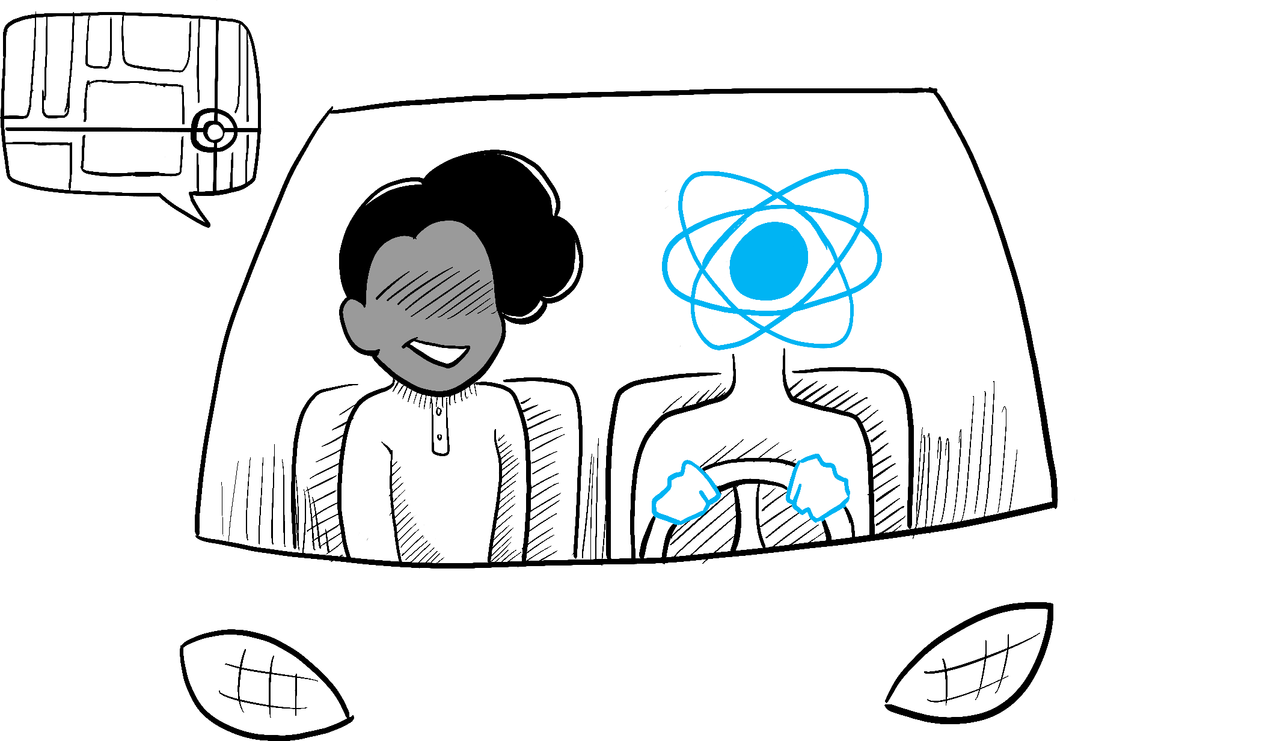
Notes:
A declarative response would be
DECLARATIVE
My address is 298 West Immutable Alley, Eden, Utah 84310

Slide 7
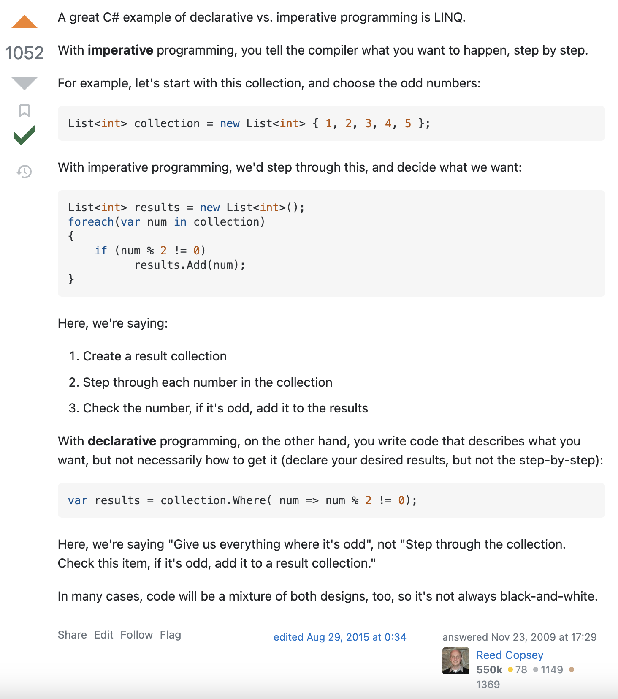

Slide 8
Notes:
https://codesandbox.io/s/kpgmzv?file=/index.js&utm_medium=sandpack
https://codesandbox.io/s/5cw764?file=/App.js&utm_medium=sandpack

Slide 9
useState

Slide 10
useReducer

Slide 11
useContext

